Slide 1

Significance-analysis
A model-based approach to comparing performance of (HPO)-algorithms
Anton Merlin Geburek
Notes:
1

Slide 2
Significance-analysis
A model-based approach to comparing performance of (HPO)-algorithms
Proposed by Riezler et al., presented tutorial at ICML
Goal of analysis: Combat Reproducibility-Crisis in AI
My contributions:
Easy to use Python-package to perform analysis
Exemplary study on HPO-algorithms
Anton Merlin Geburek
2
Notes:
2

Slide 3
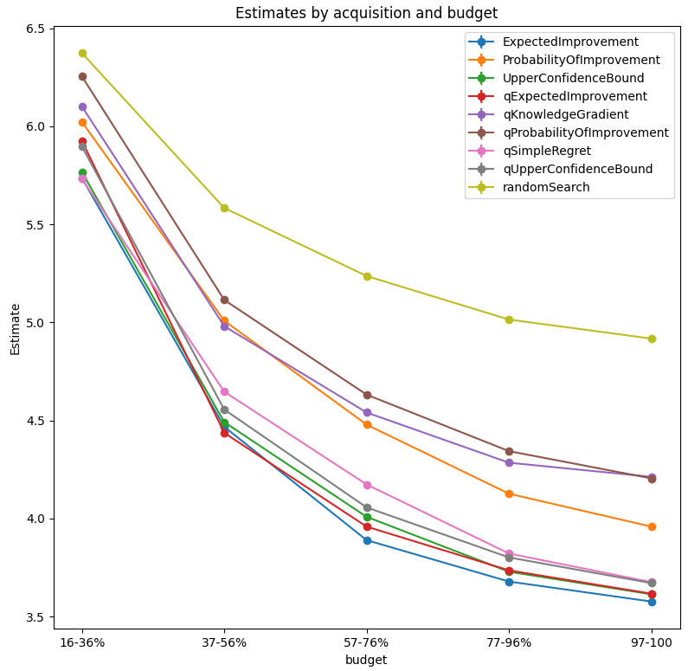
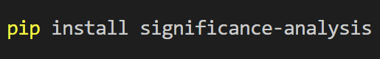
Significance-Analysis-package
Easy-to-use package with One-Line-Analysis-Tool
Customizable for all usecases of the model
Generates informative graphs and tables
Anton Merlin Geburek
https://github.com/automl/mf-prior-exp/tree/vPaper-PriorBand/
NeurIPS MetaLearn Workshop 2022
3
Notes:
3

Slide 4
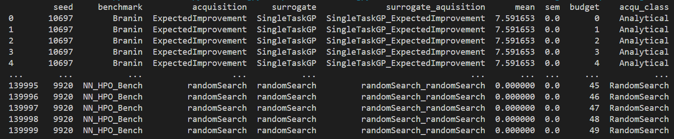

Exemplary study on HPO-algorithms
9 acquisition functions
4 benchmarks
100 random seeds
50 evaluations
→ 180 000 data points
Using
Anton Merlin Geburek
https://github.com/automl/mf-prior-exp/tree/vPaper-PriorBand/
NeurIPS MetaLearn Workshop 2022
4
Notes:
4

Slide 5
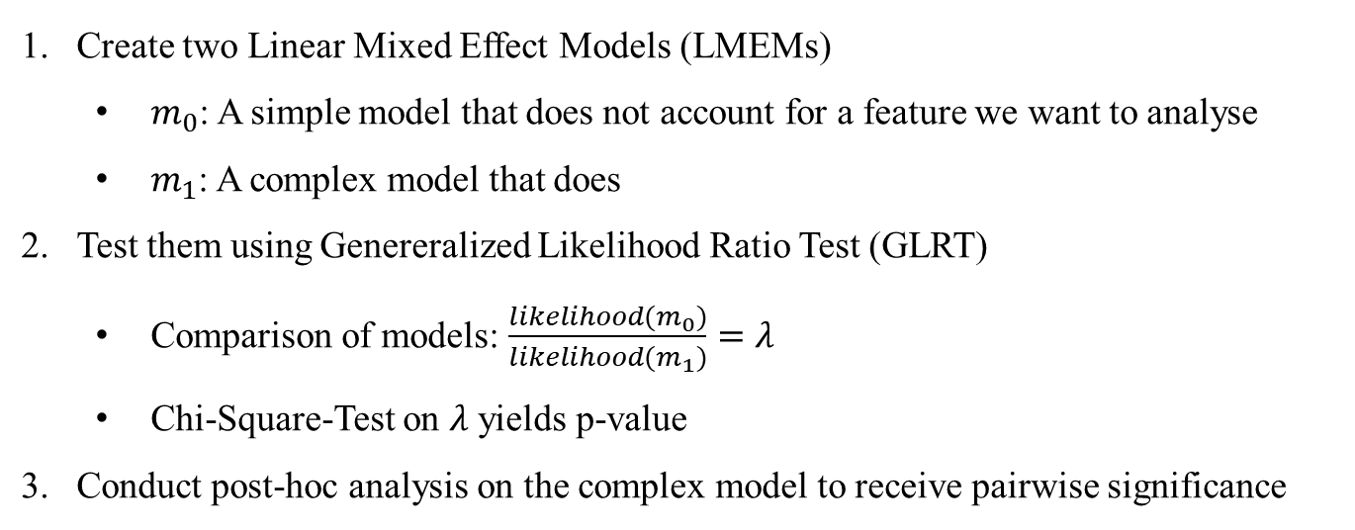
Analysis-Strategy
Create two Linear Mixed Effect Models (LMEMs)
$m_{0}$: A simple model that does not account for a feature we want to analyse
$m_{1}$: A complex model that does
Test them using Genereralized Likelihood Ratio Test (GLRT)
Comparison of models: $\frac{likelihood(m_{0})}{likelihood(m_{1})}=λ$
Chi-Square-Test on $λ$ yields p-value
Conduct post-hoc analysis on the complex model to receive pairwise significance
Anton Merlin Geburek
https://github.com/automl/mf-prior-exp/tree/vPaper-PriorBand/
NeurIPS MetaLearn Workshop 2022
5
Notes:
GLRT=Generalized Likelihood Ratio Test
Values of lambda close to 1 show that m0 is already very good, i.e. the H0 stays, while closeness to 0 shows that it explains the data poorly
5

Slide 6
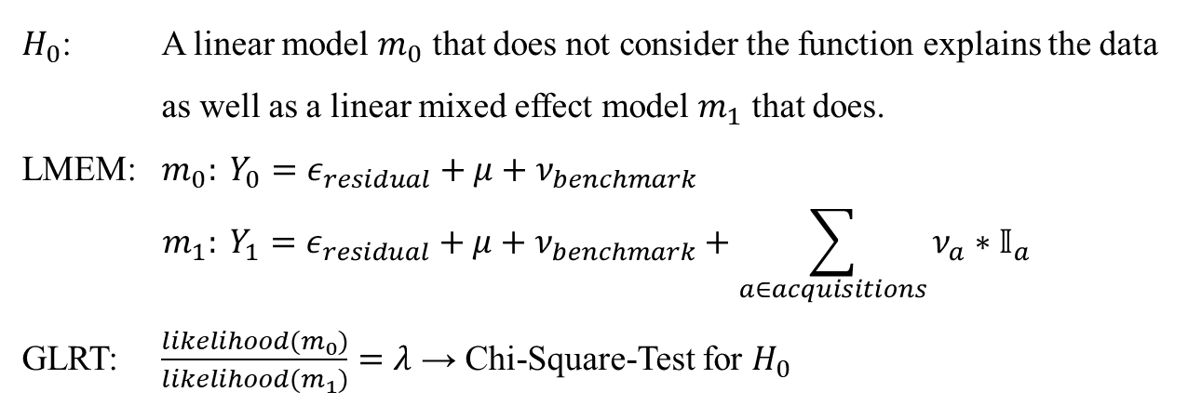
Q1: Do acquisition-functions perform significantly different?
$H_{0}$: A linear model $m_{0}$ that does not consider the function explains the data
as well as a linear mixed effect model $m_{1}$ that does.
LMEM: $m_{0}: Y_{0}=ε_{residual}+μ+ν_{benchmark}$
$$m_{1}: Y_{1}=ε_{residual}+μ+ν_{benchmark}+\sum_{a∈acquisitions}{ν_{a}∗𝕀_{a}}$$
GLRT: $\frac{likelihood(m_{0})}{likelihood(m_{1})}=λ$ → Chi-Square-Test for $H_{0}$
Anton Merlin Geburek
https://github.com/automl/mf-prior-exp/tree/vPaper-PriorBand/
NeurIPS MetaLearn Workshop 2022
6
Notes:
GLRT=Generalized Likelihood Ratio Test
Values of lambda close to 1 show that m0 is already very good, i.e. the H0 stays, while closeness to 0 shows that it explains the data poorly
6

Slide 7
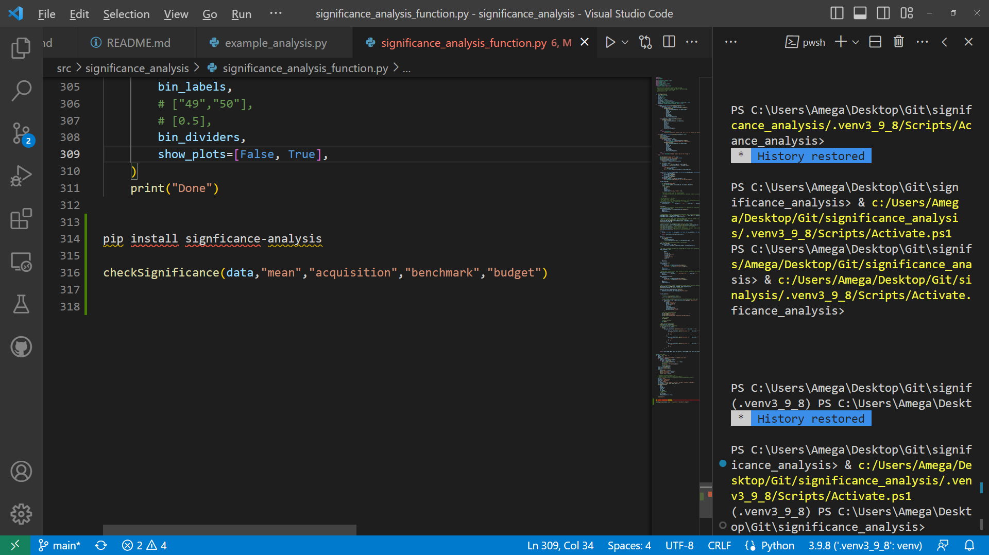
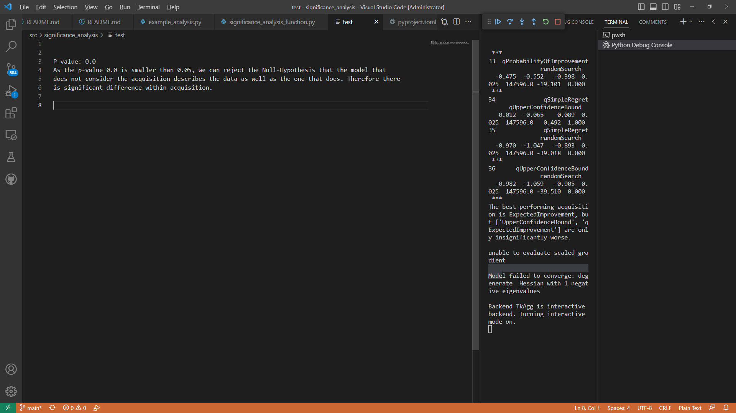
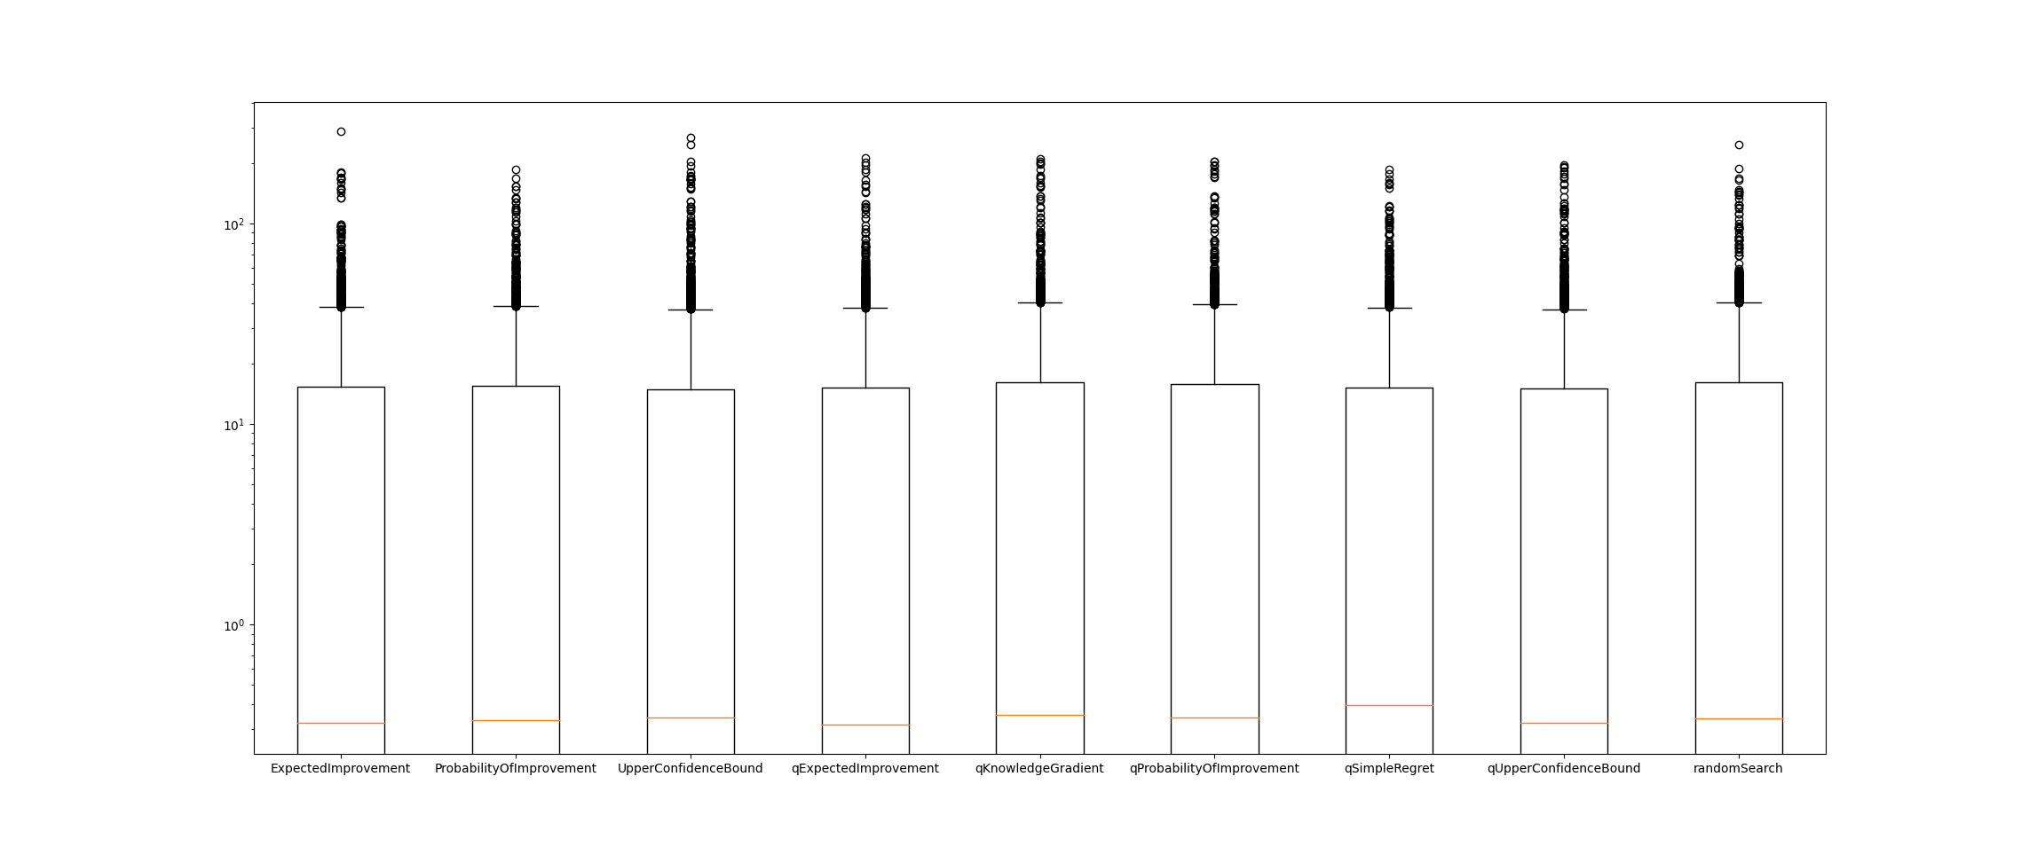
Q1: Do acquisition-functions perform significantly different?
Anton Merlin Geburek
7
Notes:
GLRT=Generalized Likelihood Ratio Test
Values of lambda close to 1 show that Theta0 is already very good, i.e. the H0 stays, while closeness to 0 shows that it explains the data poorly
7

Slide 8
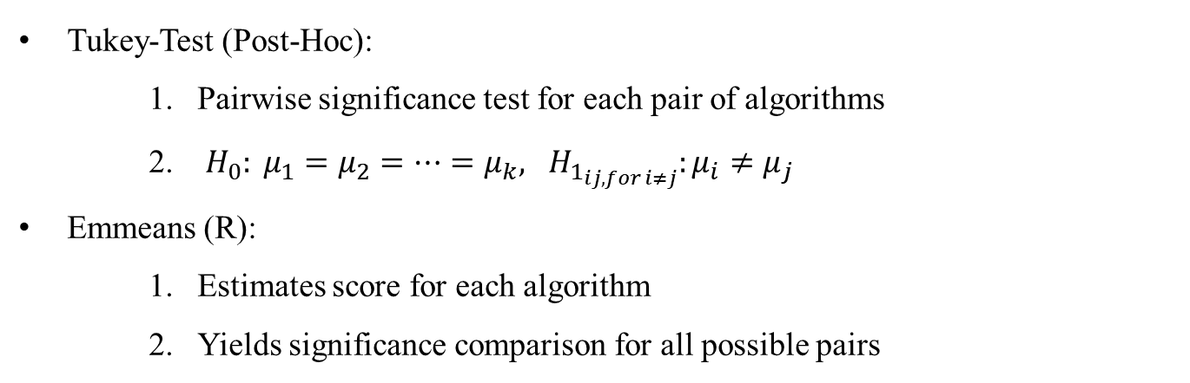
Q2: How do the acquisition-functions compare to each other?
Tukey-Test (Post-Hoc):
Pairwise significance test for each pair of algorithms
$H_{0}: μ_{1}=μ_{2}=…=μ_{k}, H_{1_{ij, for i≠j}}:μ_{i}≠μ_{j}$
Emmeans (R):
Estimates score for each algorithm
Yields significance comparison for all possible pairs
Anton Merlin Geburek
https://github.com/automl/mf-prior-exp/tree/vPaper-PriorBand/
NeurIPS MetaLearn Workshop 2022
8
Notes:
Post-Hoc Tests testen Signifikanz
8

Slide 9
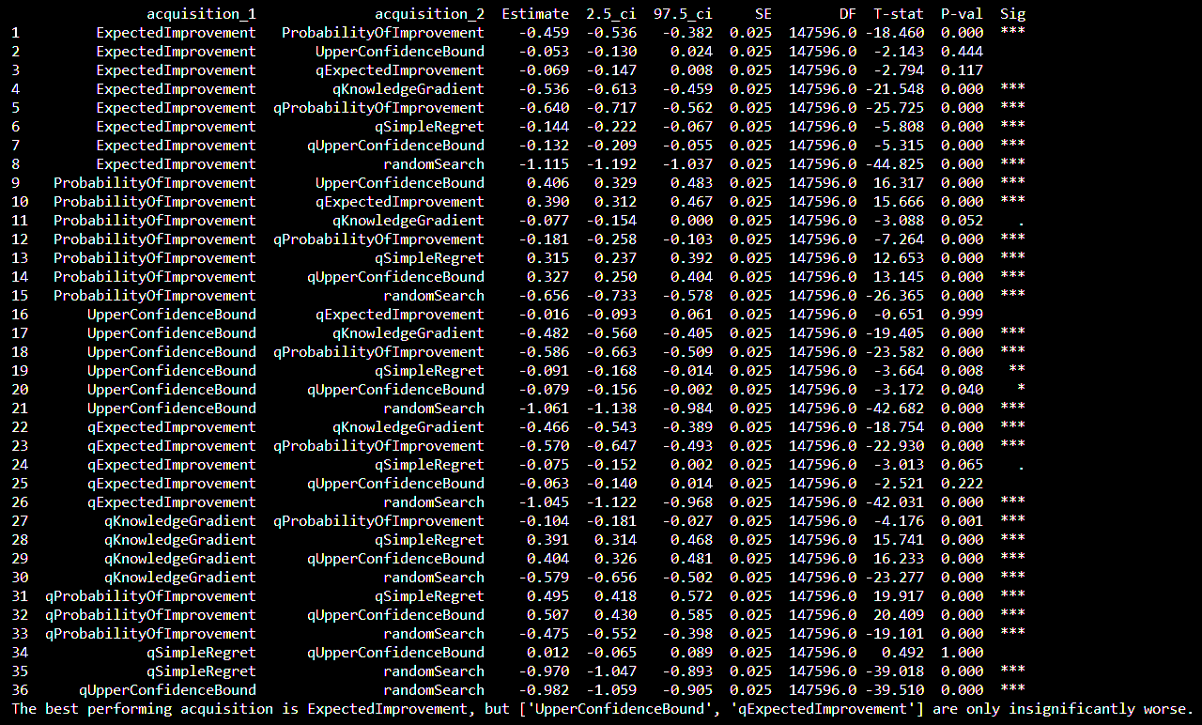
Q2: How do the acquisition-functions compare to each other?
Anton Merlin Geburek
https://github.com/automl/mf-prior-exp/tree/vPaper-PriorBand/
NeurIPS MetaLearn Workshop 2022
9
Notes:
GLRT=Generalized Likelihood Ratio Test
Values of lambda close to 1 show that Theta0 is already very good, i.e. the H0 stays, while closeness to 0 shows that it explains the data poorly
9

Slide 10
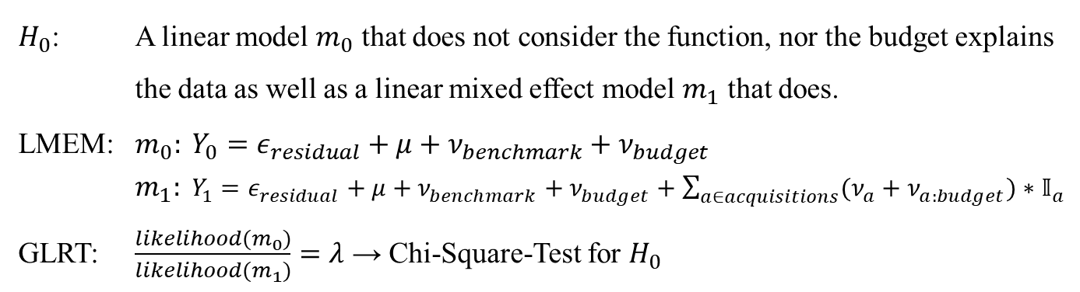
Q3: Does the performance depend on the budget?
$H_{0}$: A linear model $m_{0}$ that does not consider the function, nor the budget explains the data as well as a linear mixed effect model $m_{1}$ that does.
LMEM: $m_{0}: Y_{0}=ε_{residual}+μ+ν_{benchmark}+ν_{budget}$
$m_{1}: Y_{1}=ε_{residual}+μ+ν_{benchmark}+ν_{budget}+\sum_{a∈acquisitions}{(ν_{a}+ν_{a:budget})∗𝕀_{a}}$
GLRT: $\frac{likelihood(m_{0})}{likelihood(m_{1})}=λ$ → Chi-Square-Test for $H_{0}$
Anton Merlin Geburek
https://github.com/automl/mf-prior-exp/tree/vPaper-PriorBand/
NeurIPS MetaLearn Workshop 2022
10
Notes:
10

Slide 11
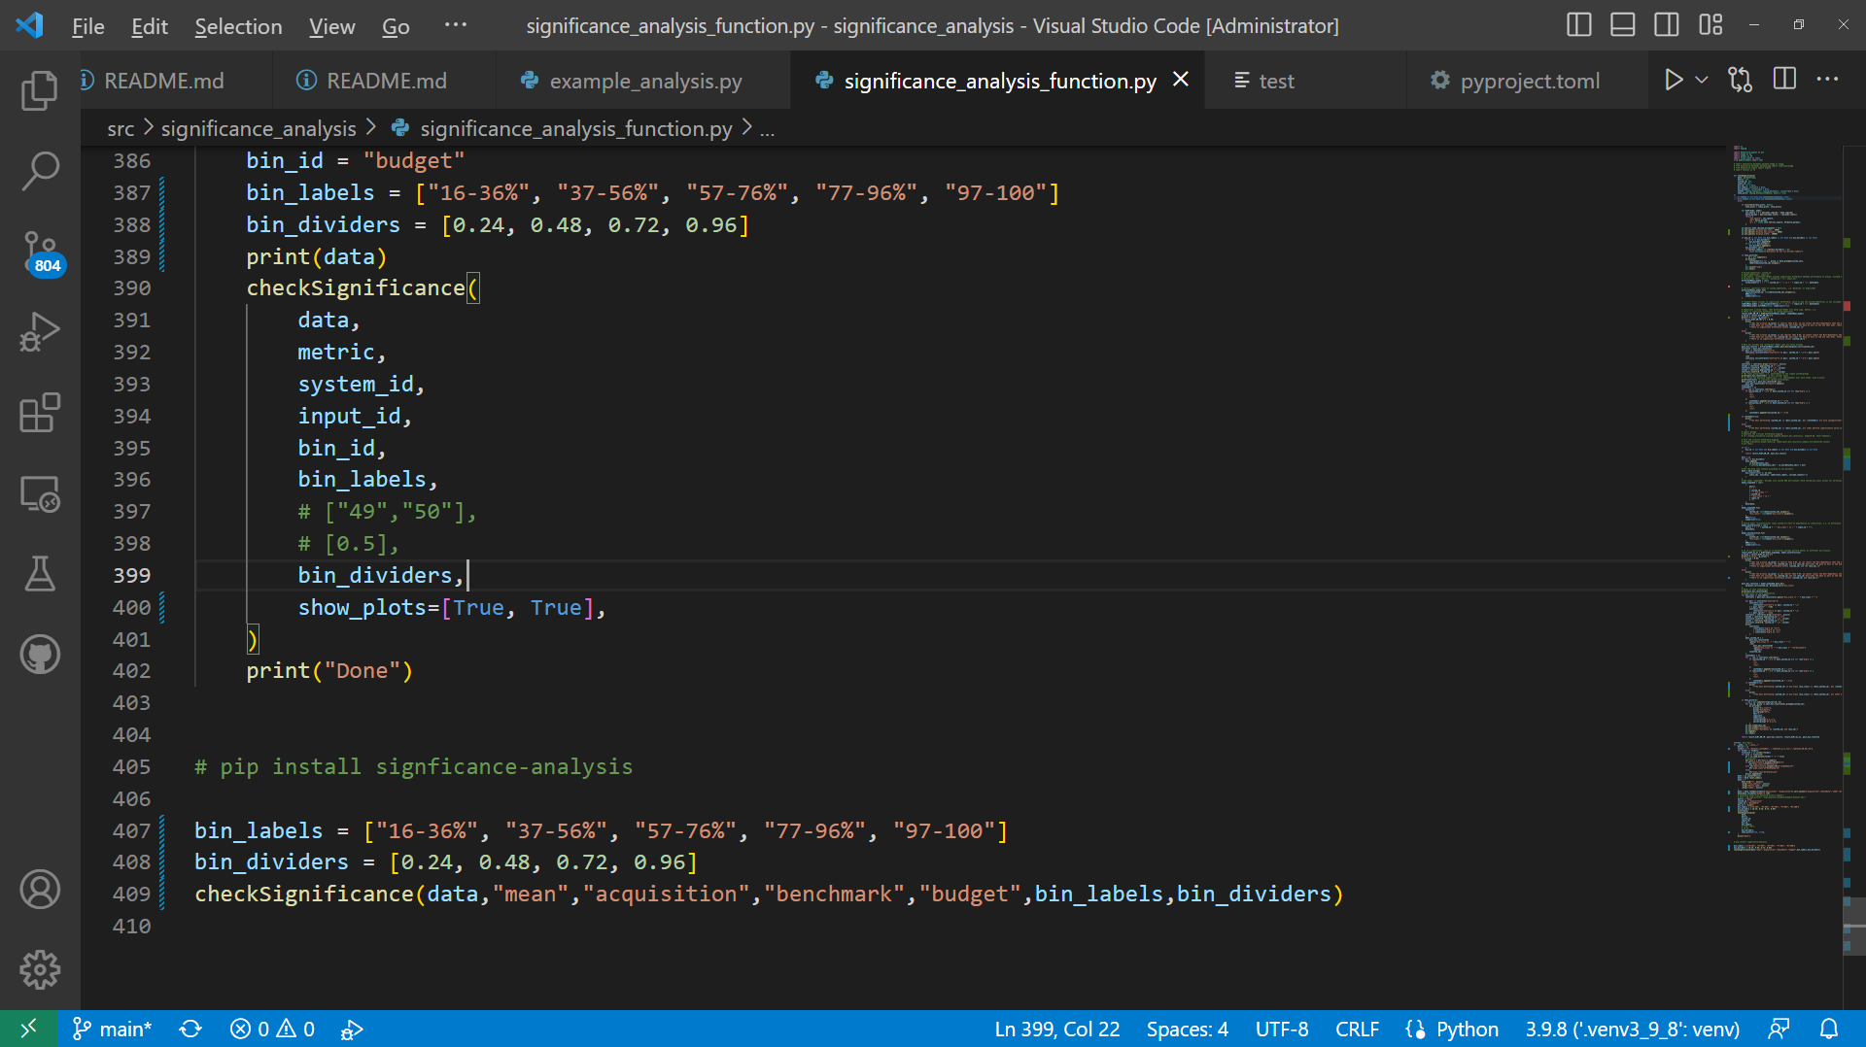
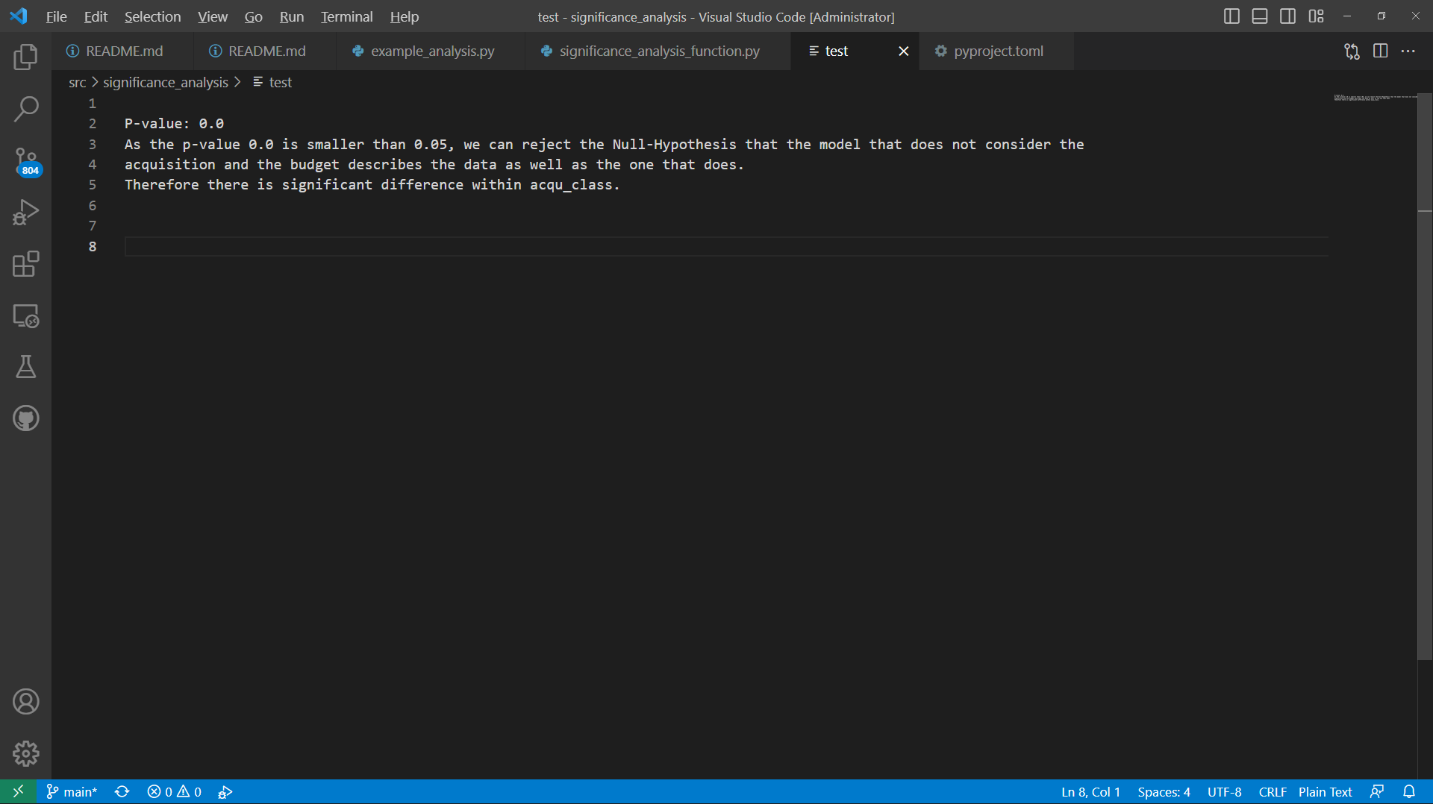
Q3: Does the performance depend on the budget?
Code:
Output:
Anton Merlin Geburek
https://github.com/automl/mf-prior-exp/tree/vPaper-PriorBand/
NeurIPS MetaLearn Workshop 2022
11
Notes:
GLRT=Generalized Likelihood Ratio Test
Values of lambda close to 1 show that Theta0 is already very good, i.e. the H0 stays, while closeness to 0 shows that it explains the data poorly
11

Slide 12
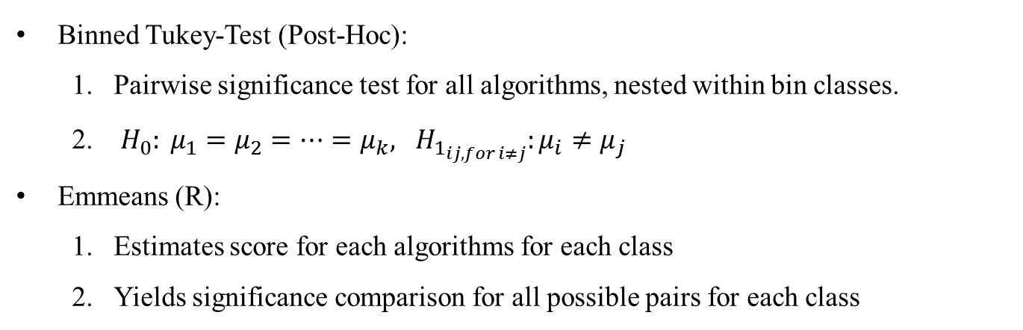
Q4: How do they compare in each budget class?
Binned Tukey-Test (Post-Hoc):
Pairwise significance test for all algorithms, nested within bin classes.
$H_{0}: μ_{1}=μ_{2}=…=μ_{k}, H_{1_{ij, for i≠j}}:μ_{i}≠μ_{j}$
Emmeans (R):
Estimates score for each algorithms for each class
Yields significance comparison for all possible pairs for each class
Anton Merlin Geburek
https://github.com/automl/mf-prior-exp/tree/vPaper-PriorBand/
NeurIPS MetaLearn Workshop 2022
12
Notes:
Post-Hoc Tests testen Signifikanz
12

Slide 13
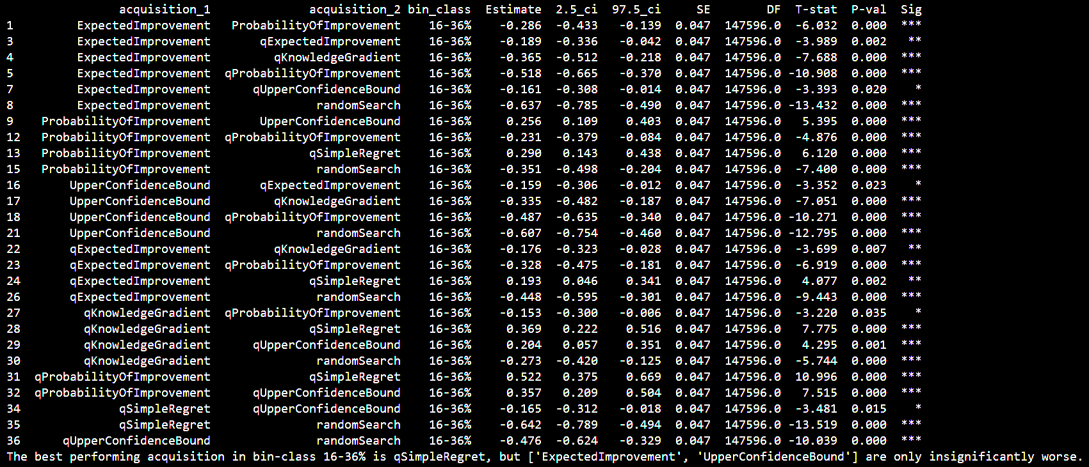
Q4: How do they compare in each budget class?
Significant performance differences for the budget bin 16-36% training
Anton Merlin Geburek
https://github.com/automl/mf-prior-exp/tree/vPaper-PriorBand/
NeurIPS MetaLearn Workshop 2022
13
Notes:
13

Slide 14
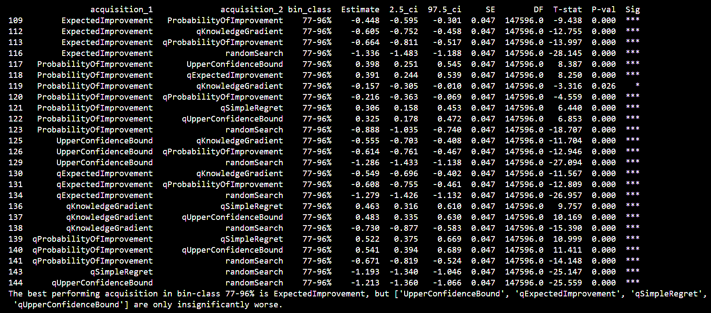
Q4: How do they compare in each budget class?
Significances in budget class 77-96% → Different acquisition functions perform better
Anton Merlin Geburek
https://github.com/automl/mf-prior-exp/tree/vPaper-PriorBand/
NeurIPS MetaLearn Workshop 2022
14
Notes:
14

Slide 15
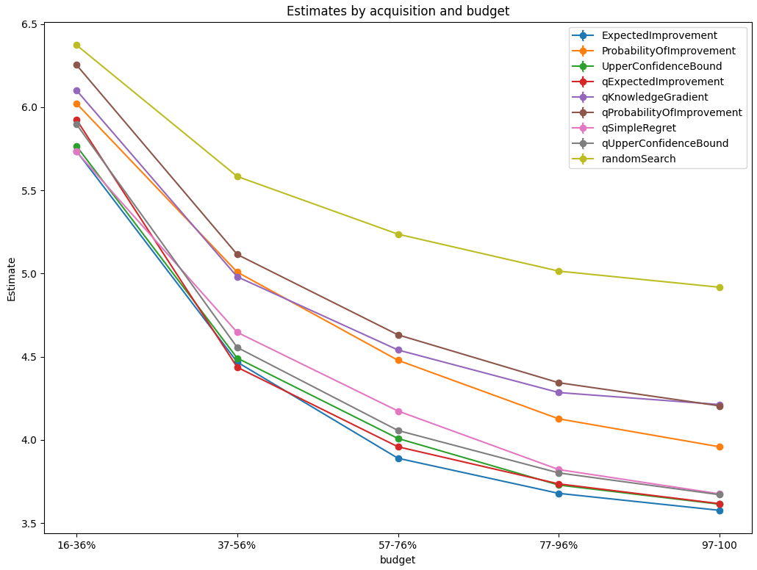
Q4: How do they compare in each budget class?
Anton Merlin Geburek
https://github.com/automl/mf-prior-exp/tree/vPaper-PriorBand/
NeurIPS MetaLearn Workshop 2022
15
Notes:
15

Slide 16
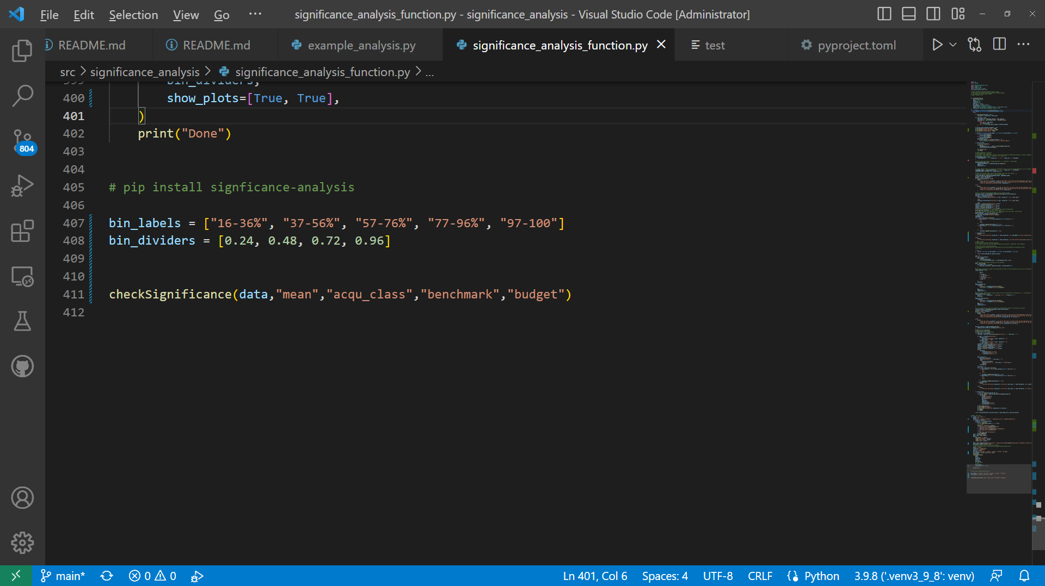
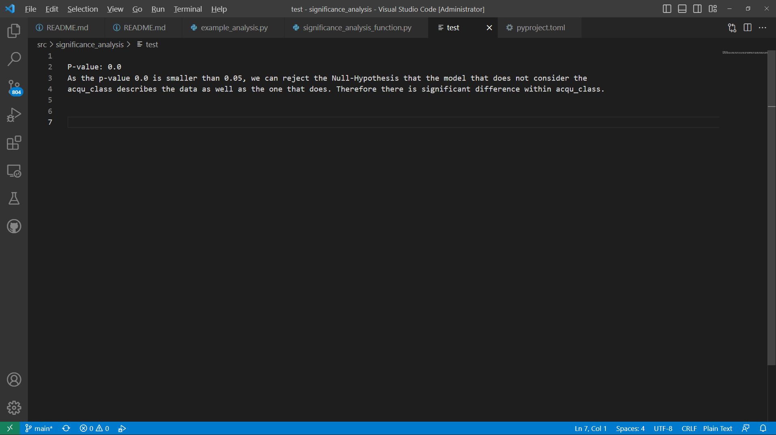
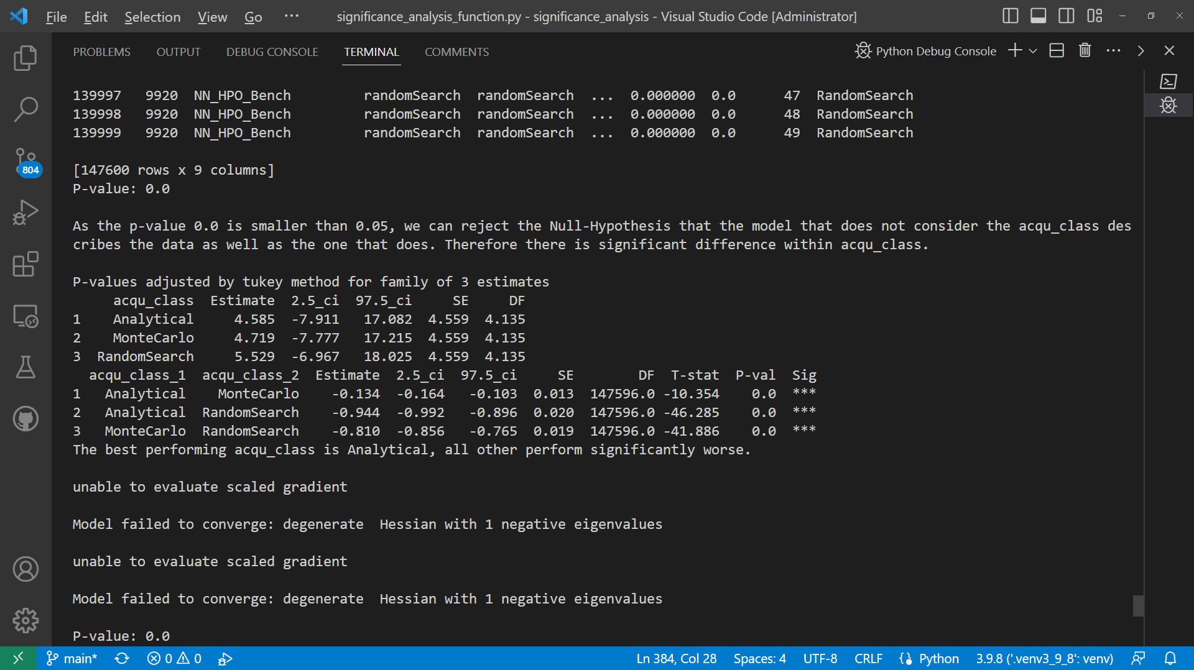
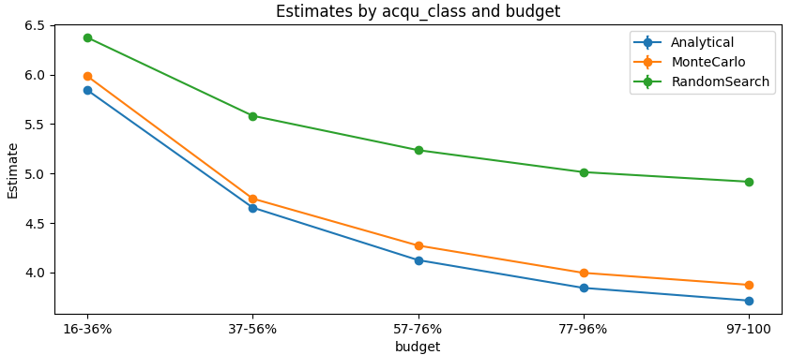
Q5: How do MC acquisition functions compare to analytical?
Small change to the code:
Output:
Anton Merlin Geburek
https://github.com/automl/mf-prior-exp/tree/vPaper-PriorBand/
NeurIPS MetaLearn Workshop 2022
16
Notes:
16

Slide 17
Summary
The presented significance testing approach offers many advantages
No gaussian-distributed data necessary
Multiple-testing-problem taken into account
Can study meta-parameter variations
My package significance-analysis provides
Quick overview with graphs
Detailed significance analysis
Anton Merlin Geburek
https://github.com/automl/mf-prior-exp/tree/vPaper-PriorBand/
NeurIPS MetaLearn Workshop 2022
17
Notes:
17

